Slide 1

Business Model Development
Umer Siddique
Founder – Techpigeon Private Limited
Cloud Evangelist – GitHub Enterprise

Slide 2
Are you an entrepreneurial spirit?
yes ________ no ______
Are you constantly thinking about how to build new businesses?
yes ________ no ______
Are you trying to find innovative ways of doing business? yes ________ no ______

Slide 3
If you’ve answered “yes” to any of these questions, welcome to our community! We’re here to take you to the long drive of crazy world of “ideas” and their development into successful business generation.

Slide 4
Canvas

Slide 5
The Lean Canvas Model
“A shared language for describing, visualizing, assessing and changing business models”
Notes:
Lean Canvas is a 1-page business plan template created by Ash Maurya that helps you deconstruct your idea into its key assumptions.

Slide 6
Def_Business Model
A business model describes how a business creates, delivers and captures value

Slide 7
The 9 Building Blocks of Canvas
CS 1 | VP 2 | CH 3 | CR 4 | R$ 5 | KR 6 | KA 7 | KP 8 | C$ 9
Customer Segments | Value Propositions | Channels | Customer Relationships | Revenue Streams | Key Resources | Key Activities | Key Partners | Cost Structure
aims to reach and serve | to create value for a customer segment | reaches to customer segment to deliver ‘VP’ | to establish relationship with customer segment | to generate cash from each customer segment i.e licensing, advertising | important assets required to make a business model work. i.e physical, intellectual, human, financial | important actions take to operate successfully. i.e production, platform | network of suppliers & partners to make the business model work. e.g alliances, Joint Venture | all costs incurred to operate a business model. e.g fixed costs, variable costs

Slide 8
Canvas

Slide 9









Lean Canvas Model
Key Partners
Key Activities
Value Proposition
Customer Relationship
Customer Segments
Key Resources
Channels
Cost Structure
Revenue Streams

Slide 10
Key Partners
Key Activities
Value Proposition
Customer Relationship
Customer Segments
Key Resources
Channels
Cost Structure
Revenue Streams

Slide 11
KP
KA
VP
CR
CS
KR
CH
C$
R$

Slide 12

KP
KA
VP
CR
CS
SOFTWARE DEVELOPMENT
MASS
CUSTOMISED
FREE INTERNET & VIDEOCALLING
CHEAP CALLS TO PHONE (SKYPEOUT)
PAYMENT PROVIDERS
DISTRIBUTION PARTNERS
TELECO PARTNERS
WEB USERS GLOBALLY
PEOPLE WHO WANT TO CALL PHONES
KR
CH
SKYPE.COM
SKYPE APP (ANDROID, IOS, WIN) HEADSET PARTNERSHIPS
SOFTWARE
DEVELOPERS
SOFTWARE
C$
R$
FREE SKYPEOUT PRE-PAID OR SUBSCRIPTIONS HARDWARE SALES
SOFTWARE DEVELOPMENT COMPLAINT MANAGEMENT

Slide 13
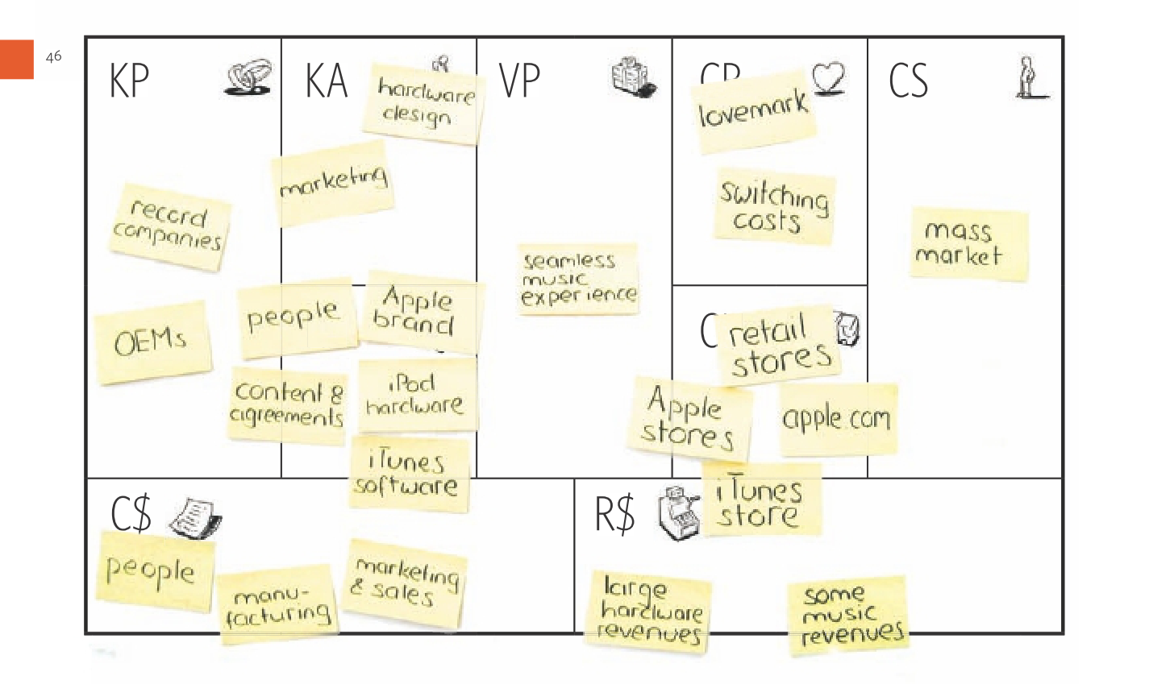
Which Company’s Product Business Model?

Slide 14
Canvas Model Design Group Activity

Slide 15
KP
KA
VP
CR
CS
KR
CH
C$
R$

Slide 16

KP
KA
VP
CR
CS
Platform Development
Optimizing Ads
and Content
Feed, Reviews,
Comments
YouTube Studio
Search & Watch
Videos Free
Upload Content to
make money
Google AdSense
Viewers
Creators
Advertisers
KR
CH
Youtube.com
YouTube Web, APP Smart Tv
Algorithms
Data Platforms 1.5 billion active users
C$
R$
FREEMIUM PREMIUM PAID ADS
Maintenance & Development
Team Cost
Data Centers

Slide 17


Slide 18
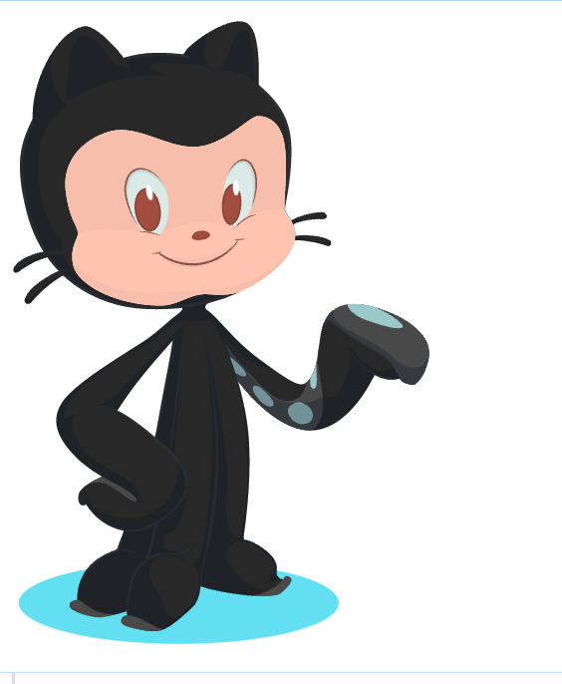







GitHub Education
Teach and learn better, together.
GitHub is free for students and teachers.
Discounts available for other educational uses.
GitHub Campus
https://education.github.com/pack
Student Developer Program

Slide 19

GitHub Education
Automate, customize, and execute your software development
workflows right in your repository with GitHub Actions.

Slide 20
KP
KA
VP
CR
CS
Development & Maintenance
Security & Update of Platform
Self-service
Consumer Support (GitHub One)
Opensource & IT
Community
Individuals Free Users
Organizations Paid
Licenses
Store, track & Control
Versions of code
Development Projects
3rd Party Integrators
KR
CH
github.com
Sales Team
GitHub Platform
33 Million users & its repositories
C$
R$
FREEMIUM PREMIUM
Personal
Cloud Infrastructures

Slide 21
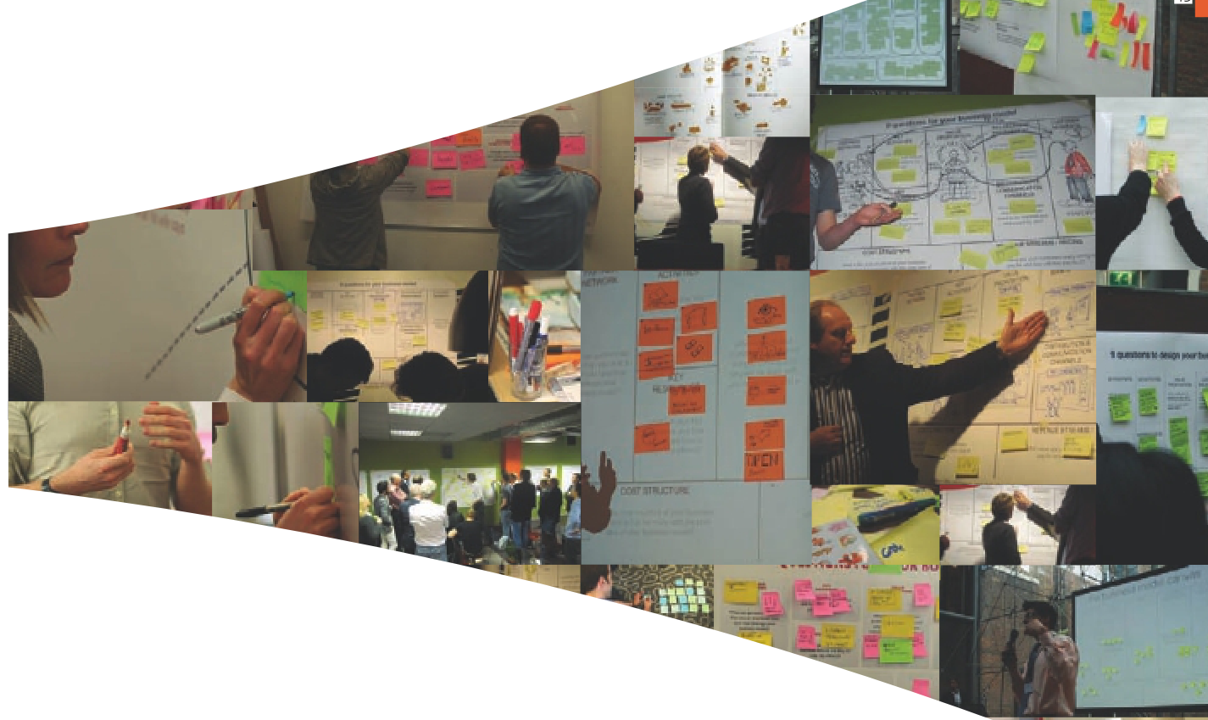
Lean Canvas Model Practice(s)

Slide 22
Activity
Put the Chart on the wall
2
3
Plot the canvas on a Chart
Sketch out your business model with sticky notes and pencil
1

Slide 23
Contact Us
www.Techpigeon.org
https://techpigeon-smc-private-limited.dmc-microsite.com/
Email: hello@techpigeon.org
Phone: +92 (300) 0529696
WhatsApp: +1 (786) 8226386
https://www.facebook.com/techpigeon/
hello@techpigeon.org

